Slide 1
23CY101 – NETWORKING AND COMMUNICATION
Subject Code :23CY101
Subject Name: Networking and Communication
Faculty Name: E Praveen Kumar, AP/IoT
Academic Year: 23-24 (ODD)

Slide 2

23CY101 – NETWORKING AND COMMUNICATION
MODULE 3
Transport layer and Application Layer: UDP – TCP – Congestion Control and Resource Allocation: TCP Congestion Control – Congestion Avoidance Mechanisms – Quality of Service: Integrated Services – Differentiated Services – Network Traffic Analysis. Domain Name System – Electronic Mail (SMTP, MIME, IMAP) – File Transfer (FTP) – WWW (HTTP). Emerging Technologies in Networking (5G, edge computing, etc.), Securing web applications, Mobile Phone security, Data Tracking. Case study: Evaluating the impact of 5G and edge computing on the future of network communication.
CO4 | Analyze IP, TCP and UDP header formats. | [AN]
CO5 | Analyze Network traffic characteristics and congestion control mechanism. | [AN]
1

Slide 3
23CY101 – NETWORKING AND COMMUNICATION
MODULE 3
3.1
UDP – TCP
3.2
Congestion Control and Resource Allocation: TCP Congestion Control
3.3
Congestion Avoidance Mechanisms
3.4
Quality of Service: Integrated Services
3.5
Differentiated Services, Network Traffic Analysis
3.6
Domain Name System – Electronic Mail (SMTP, MIME, IMAP)
3.7
File Transfer (FTP) – WWW (HTTP)
3.8
Emerging Technologies in Networking (5G, edge computing, etc.), Securing web applications, Mobile Phone security
3.9
Data Tracking. Case study: Evaluating the impact of 5G and edge computing on the future of network communication.
MODULE: 3 2

Slide 4
23CY101 – NETWORKING AND COMMUNICATION
Transport Layer – UDP - TCP
Video Link
Transport Layer
The transport layer is responsible for process-to-process delivery—the delivery of a packet, part of a message, from one process to another.
Two processes communicate in a client/server relationship.
MODULE: 3 3

Slide 5
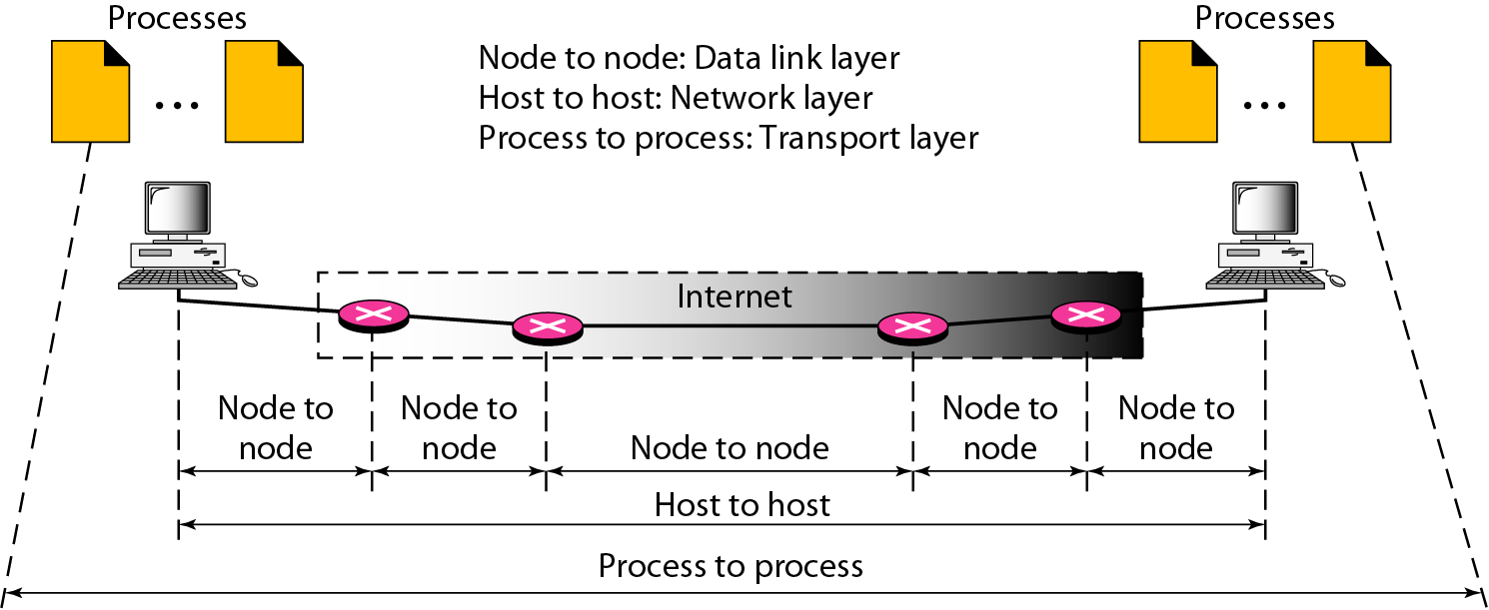
23CY101 – NETWORKING AND COMMUNICATION
Transport Layer – UDP - TCP
Types of data deliveries
MODULE: 3 4

Slide 6
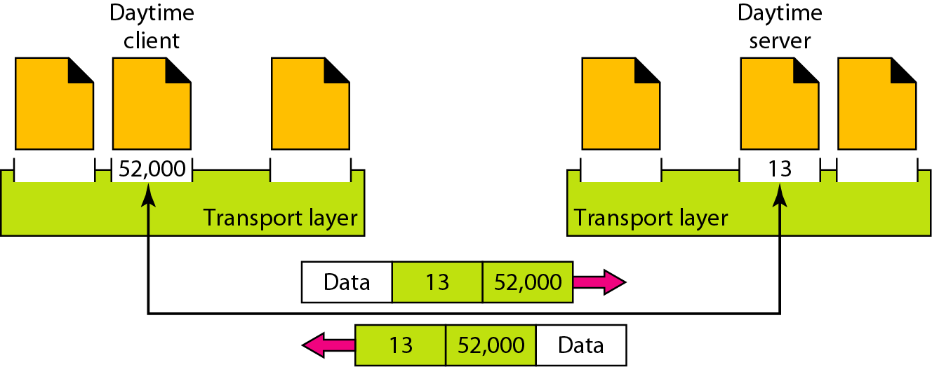
23CY101 – NETWORKING AND COMMUNICATION
Transport Layer – UDP - TCP
Port Numbers
MODULE: 3 5

Slide 7
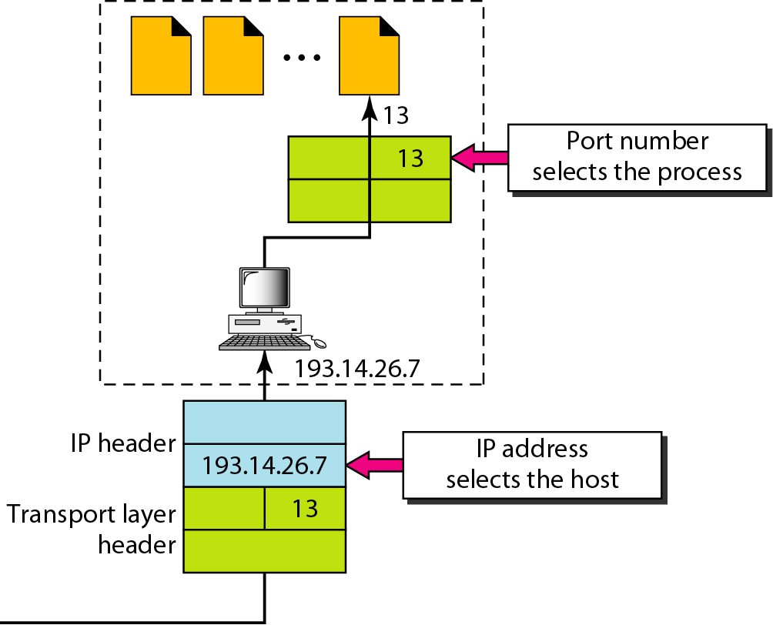
23CY101 – NETWORKING AND COMMUNICATION
Transport Layer – UDP - TCP
IP addresses versus port numbers
MODULE: 3 6

Slide 8
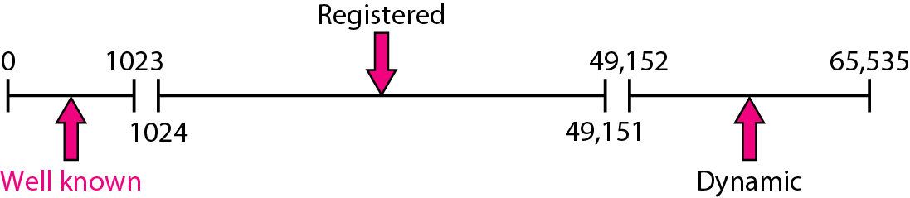
23CY101 – NETWORKING AND COMMUNICATION
Transport Layer – UDP - TCP
IANA ranges
MODULE: 3 7

Slide 9
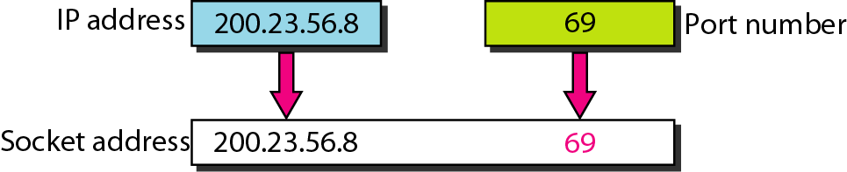
23CY101 – NETWORKING AND COMMUNICATION
Transport Layer – UDP - TCP
Socket address
MODULE: 3 8

Slide 10
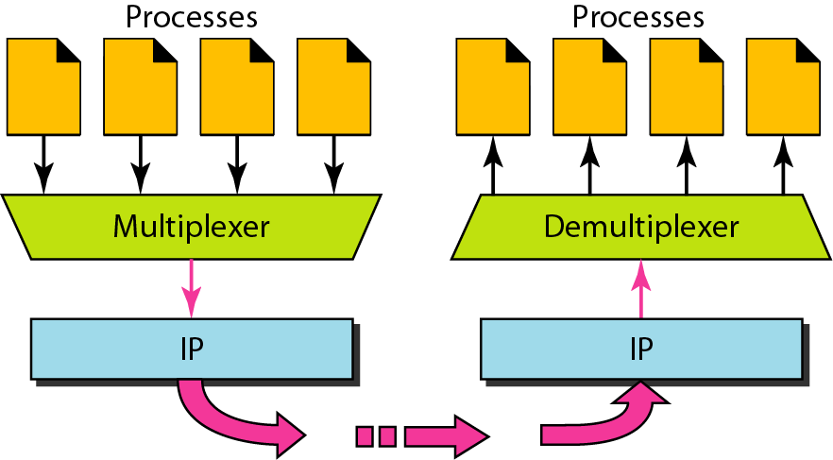
23CY101 – NETWORKING AND COMMUNICATION
Transport Layer – UDP - TCP
Multiplexing and Demultiplexing
MODULE: 3 9

Slide 11
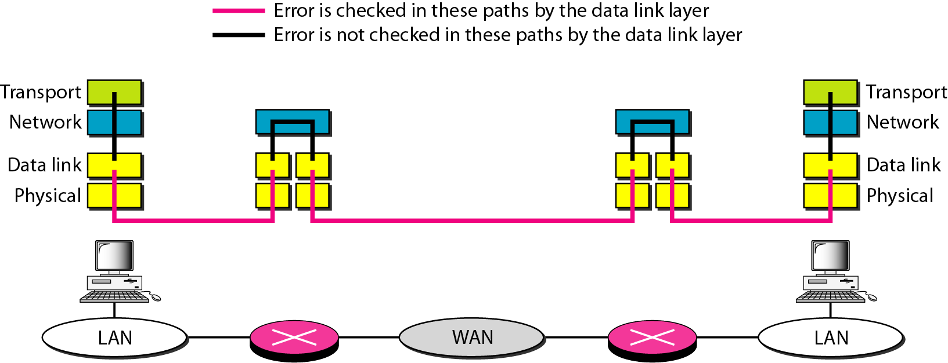
23CY101 – NETWORKING AND COMMUNICATION
Transport Layer – UDP - TCP
Error control
MODULE: 3 10

Slide 12
23CY101 – NETWORKING AND COMMUNICATION
Transport Layer – UDP - TCP
UDP
Video Link
The User Datagram Protocol (UDP) is called a connectionless, unreliable transport protocol. It does not add anything to the services of IP except to provide process-to-process communication instead of host-to-host communication.
Well-Known Ports for UDP
User Datagram
Checksum
UDP Operation
Use of UDP
MODULE: 3 11

Slide 13
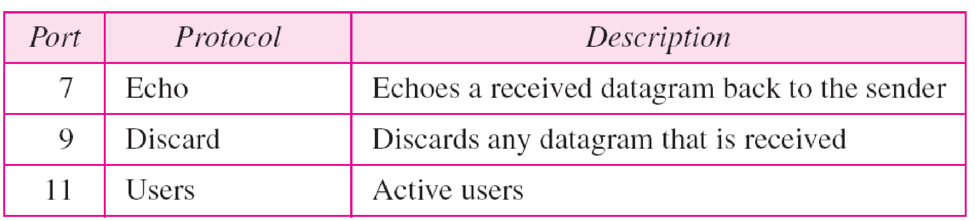
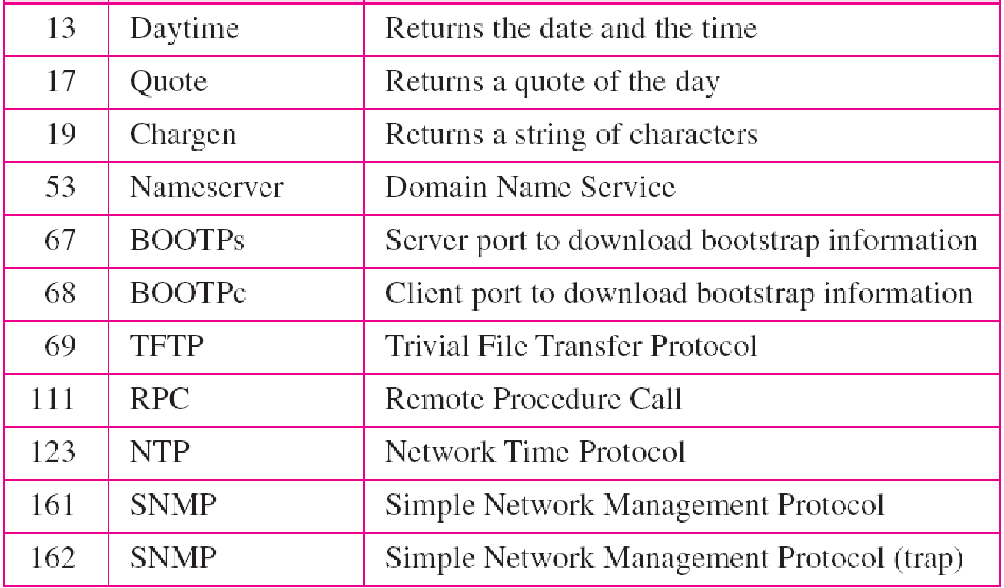
23CY101 – NETWORKING AND COMMUNICATION
Transport Layer – UDP - TCP
Well-known ports used with UDP
MODULE: 3 12

Slide 14
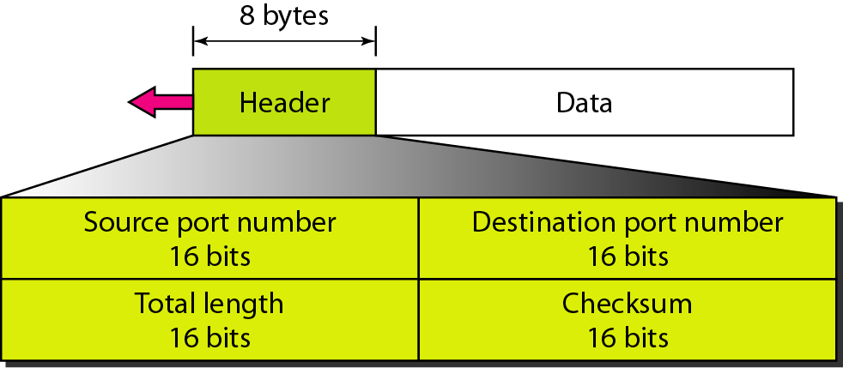
23CY101 – NETWORKING AND COMMUNICATION
Transport Layer – UDP - TCP
User datagram format
UDP length = IP length – IP header’s length
MODULE: 3 13

Slide 15
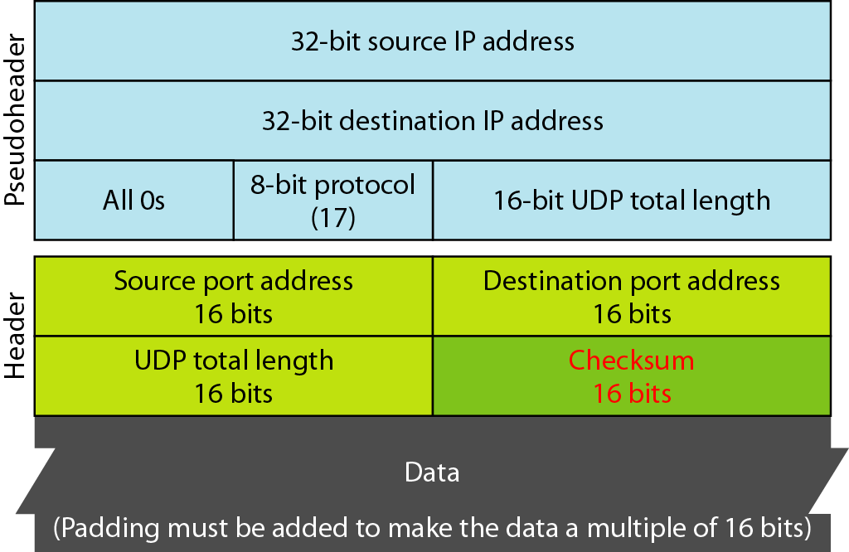
23CY101 – NETWORKING AND COMMUNICATION
Transport Layer – UDP - TCP
Pseudoheader for checksum calculation
MODULE: 3 14

Slide 16
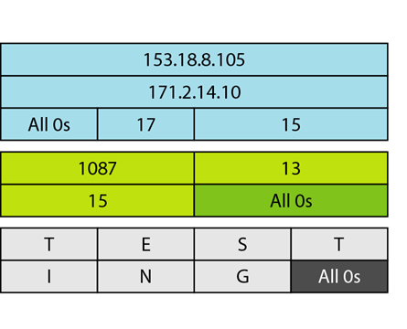
23CY101 – NETWORKING AND COMMUNICATION
Transport Layer – UDP - TCP
Checksum calculation of a simple UDP user datagram
MODULE: 3 15

Slide 17
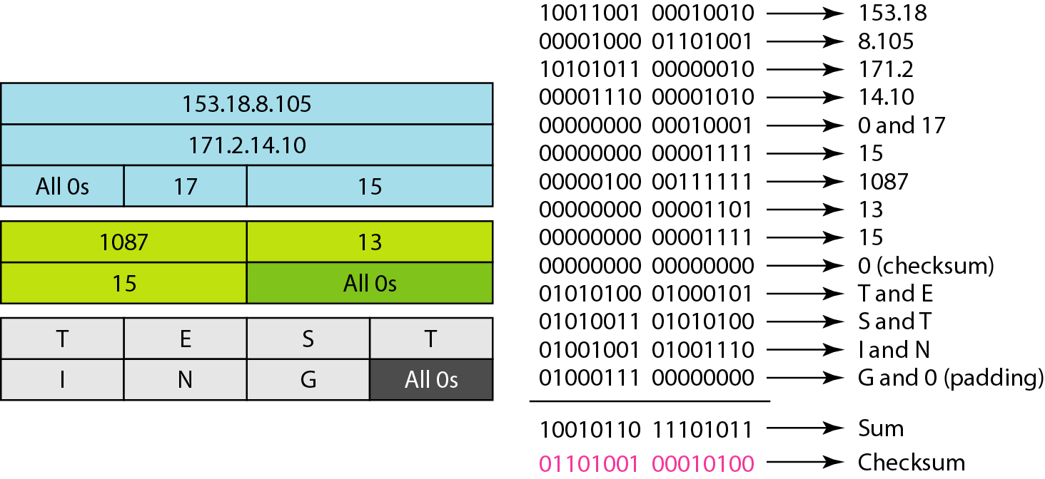
23CY101 – NETWORKING AND COMMUNICATION
Transport Layer – UDP - TCP
Checksum calculation of a simple UDP user datagram
MODULE: 3 16

Slide 18
23CY101 – NETWORKING AND COMMUNICATION
Transport Layer – UDP - TCP
UDP Operation
Connectionless services
Flow and error control
Encapsulation and Decapsulation
Queuing
MODULE: 3 17

Slide 19
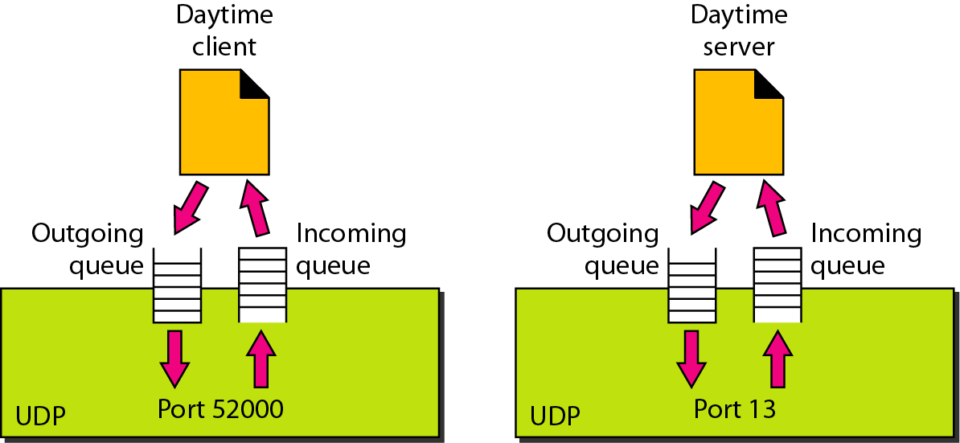
23CY101 – NETWORKING AND COMMUNICATION
Transport Layer – UDP - TCP
Queues in UDP
MODULE: 3 18

Slide 20
23CY101 – NETWORKING AND COMMUNICATION
Transport Layer – UDP - TCP
Use of UDP
Suitable for a process that requires simple request-response communication with little concern for flow and error control
Suitable for a process with internal flow and error control mechanisms. For example, the TFTP process includes flow and error control
Suitable for multicasting. Multicasting capability is embedded in the UDP software but not in the TCP software
Used for management processes (SNMP)
Used for some route updating protocols (RIP)
MODULE: 3 19

Slide 21
23CY101 – NETWORKING AND COMMUNICATION
Transport Layer – UDP - TCP
TCP
Transmission Control Protocol (TCP) is a connection-oriented, reliable transport protocol.
It creates a virtual connection between two TCPs to send data.
In addition, TCP uses flow and error control mechanisms at the transport level.
Video Link1
Video Link2
MODULE: 3 20

Slide 22
TCP Services
23CY101 – NETWORKING AND COMMUNICATION
Transport Layer – UDP - TCP
Process to process communication
Stream Delivery Service
Sending and Receiving Buffers
Segments
Full-Duplex Communication
Connection-Oriented Service
Reliable Service
MODULE: 3 21

Slide 23
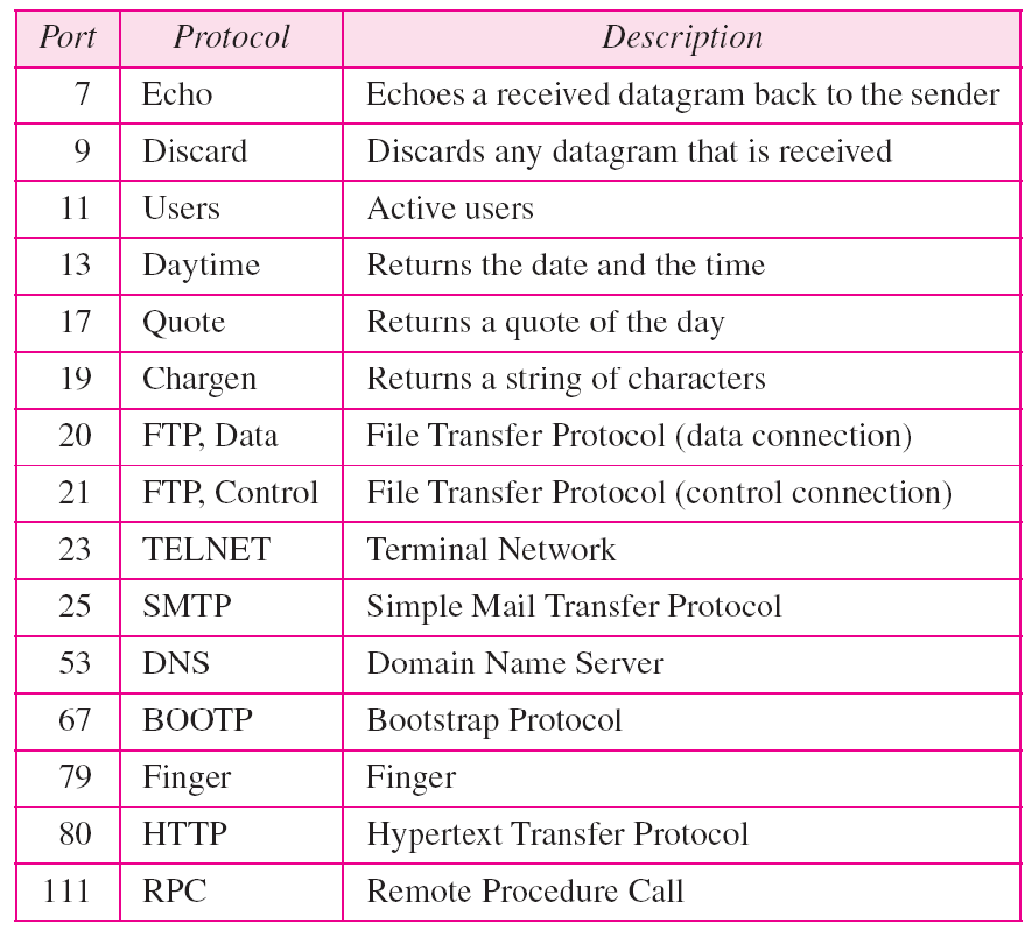
Process to Process Communication
23CY101 – NETWORKING AND COMMUNICATION
Transport Layer – UDP - TCP
Well known ports
Like UDP, TCP provides process-to-process communication using port numbers
Table2 lists some well-known port numbers used by TCP
MODULE: 3 22

Slide 24
Stream Delivery Service
23CY101 – NETWORKING AND COMMUNICATION
Transport Layer – UDP - TCP
Allows the sending process to deliver data – as a stream of bytes
Allows the receiving process to obtain data - as a stream of bytes
TCP creates an environment in which the two processes seem to be connected by an imaginary “tube” that carries their data across the Internet
The sending process produces (writes to) the stream of bytes
The receiving process consumes (reads from) them
MODULE: 3 23

Slide 25
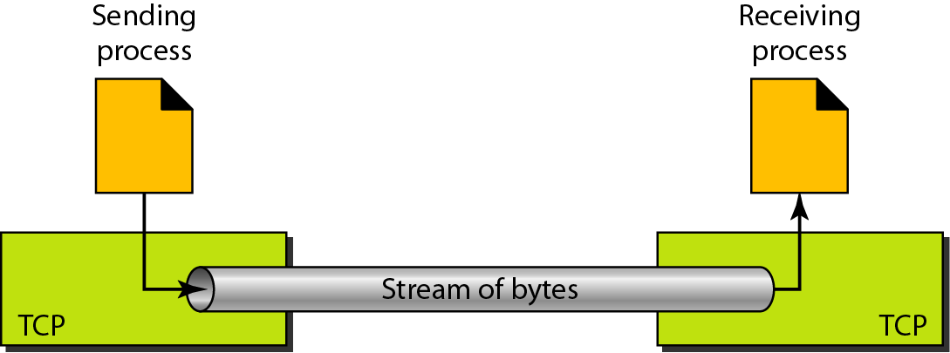
Stream Delivery
23CY101 – NETWORKING AND COMMUNICATION
Transport Layer – UDP - TCP
MODULE: 3 24

Slide 26
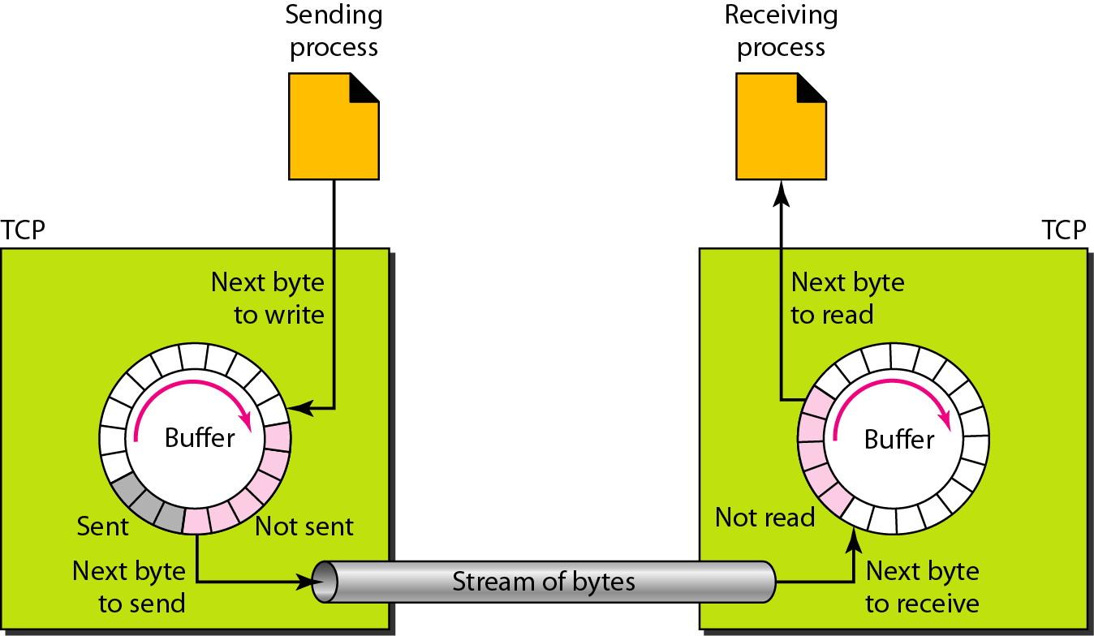
Sending and Receiving Buffers
23CY101 – NETWORKING AND COMMUNICATION
Transport Layer – UDP - TCP
MODULE: 3 25

Slide 27
Sending and Receiving Buffers
23CY101 – NETWORKING AND COMMUNICATION
Transport Layer – UDP - TCP
TCP needs buffers for storage
Two buffers: sending and receiving
Implement a buffer is – to use a circular array of 1-byte locations
Fig. shown two buffers of 20 bytes each
Sending site: three types of chambers
Receiver site: two areas
MODULE: 3 26

Slide 28
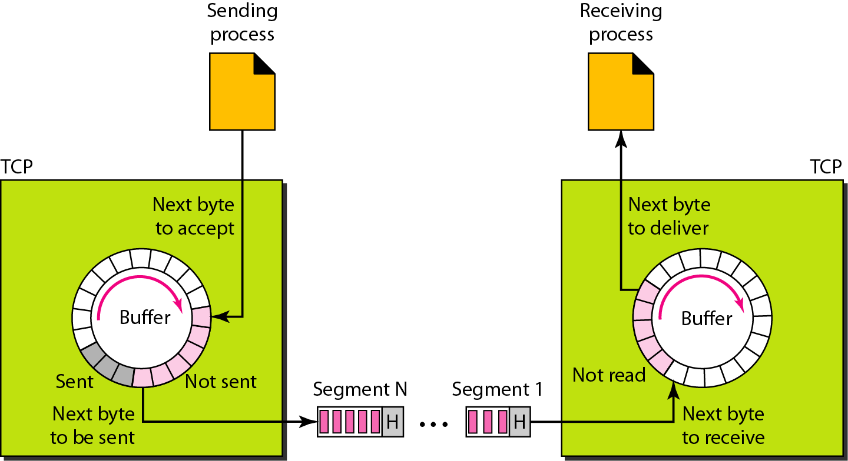
TCP Segments
23CY101 – NETWORKING AND COMMUNICATION
Transport Layer – UDP - TCP
MODULE: 3 27

Slide 29
TCP Segments
23CY101 – NETWORKING AND COMMUNICATION
Transport Layer – UDP - TCP
Although buffering handles the disparity between the speed of the producing and consuming processes, we need one more step before we can send data
The IP layer, as a service provider for TCP, needs to send data in packets, not as a stream of bytes
TCP groups a number of bytes together into a packet called a segment
TCP adds a header to each segment and delivers the segment to the IP layer for transmission
The segments are encapsulated in IP datagrams and transmitted
MODULE: 3 28

Slide 30
Full-Duplex Communication
23CY101 – NETWORKING AND COMMUNICATION
Transport Layer – UDP - TCP
Data can flow in both directions at the same time
Each TCP then has a sending and receiving buffers, and segments move in both directions
MODULE: 3 29

Slide 31
Connection Oriented Service
23CY101 – NETWORKING AND COMMUNICATION
Transport Layer – UDP - TCP
Site A want to send
Receive data at site B
The two TCPs establish a connection between them
Data are exchanged in both directions
The connection is terminated
Reliable Service
Uses an acknowledgment mechanism to check the safe and sound arrival of data
MODULE: 3 30

Slide 32
23CY101 – NETWORKING AND COMMUNICATION
Transport Layer – UDP - TCP
The bytes of data being transferred in each connection are numbered by TCP.
The numbering starts with a randomly generated number.
MODULE: 3 31

Slide 33
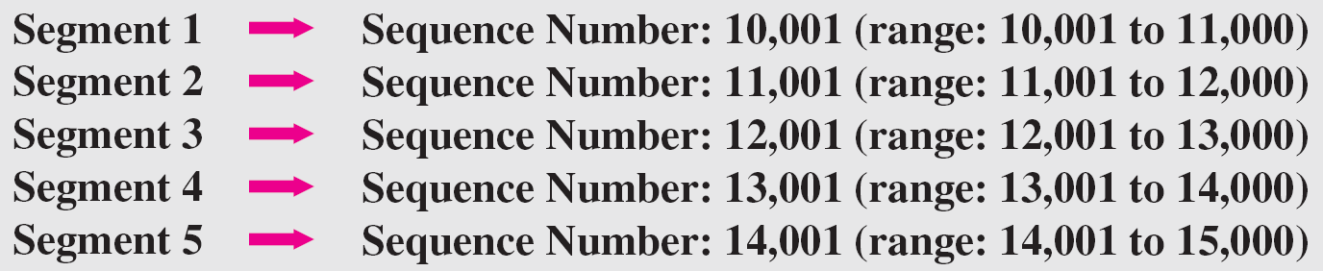
TCP Features
23CY101 – NETWORKING AND COMMUNICATION
Transport Layer – UDP - TCP
Numbering system: two fields called the sequence number and the acknowledgment number
These two fields refer to the byte number and not the segment number
Byte Number: TCP numbers all data bytes that are transmitted in a connection
Sequence Number: after the bytes have been numbers, TCP assigns a sequence number to each segment that is being sent
MODULE: 3 32

Slide 34
23CY101 – NETWORKING AND COMMUNICATION
Transport Layer – UDP - TCP
The value in the sequence number field of a segment defines the
number of the first data byte contained in that segment.
The value of the acknowledgment field in a segment defines
the number of the next byte a party expects to receive.
The acknowledgment number is cumulative.
MODULE: 3 33

Slide 35
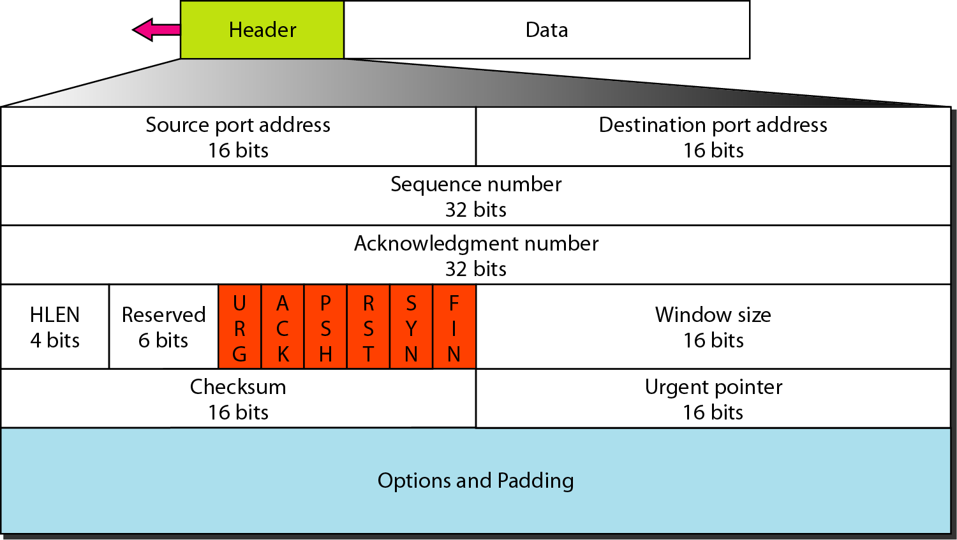
23CY101 – NETWORKING AND COMMUNICATION
Transport Layer – UDP - TCP
TCP Segment Format
MODULE: 3 34

Slide 36
23CY101 – NETWORKING AND COMMUNICATION
Transport Layer – UDP - TCP
TCP Segment Format
Segment consists of a 20 to 60 byte header, followed by data from the application program
The header is 20 bytes if there are no options and up to 60 bytes if it contains options
Source port address: 16-bit field, sending the segment
Destination port address: 16-bit field, receiving the segment
Sequence number: the number assigned to the first byte of data contained in this segment
Each byte to be transmitted is numbered
Acknowledgment number: expecting to receive from the other party
Header length: indicated the number of 4-byte words in the TCP header, therefore the value of this field can be between 5 (5x 4 = 20) and 15 (15 x 4 = 60)
Reserved: reserved for future use
Control: 6 different control bits or flags; one or more of these bits can be set at a time
MODULE: 3 35

Slide 37
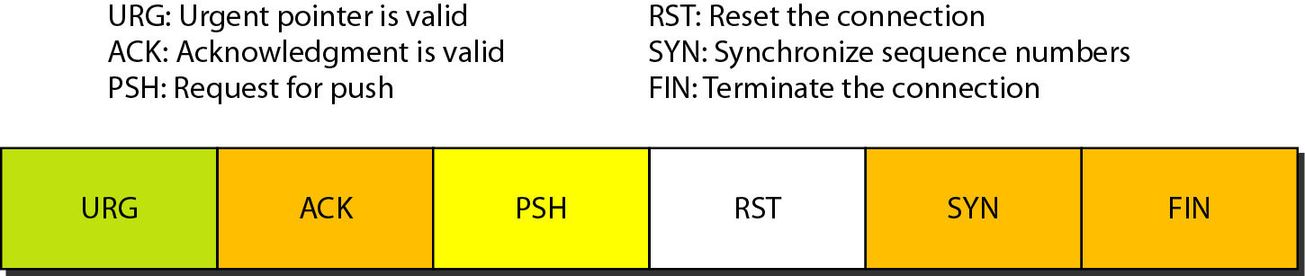
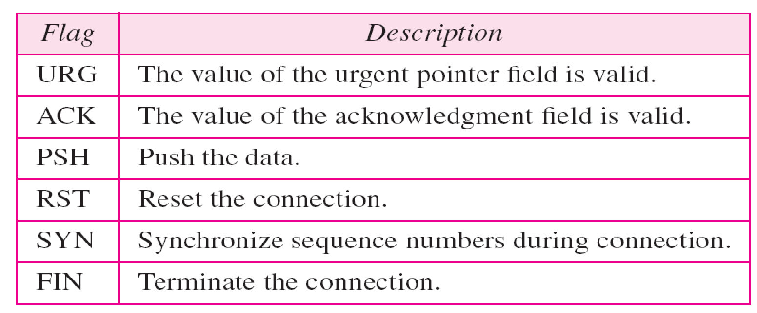
23CY101 – NETWORKING AND COMMUNICATION
Transport Layer – UDP - TCP
Control Field
MODULE: 3 36

Slide 38
23CY101 – NETWORKING AND COMMUNICATION
Transport Layer – UDP - TCP
Control Field
Window size: defines the size of the window; maximum size is 65,535 bytes
This value is normally referred to as the receiving window (rwnd) and is determined by the receiver
Check sum: error control
Urgent pointer: valid only if the urgent flag is set, is used when the segment contains urgent data
Options: optional information
MODULE: 3 37

Slide 39
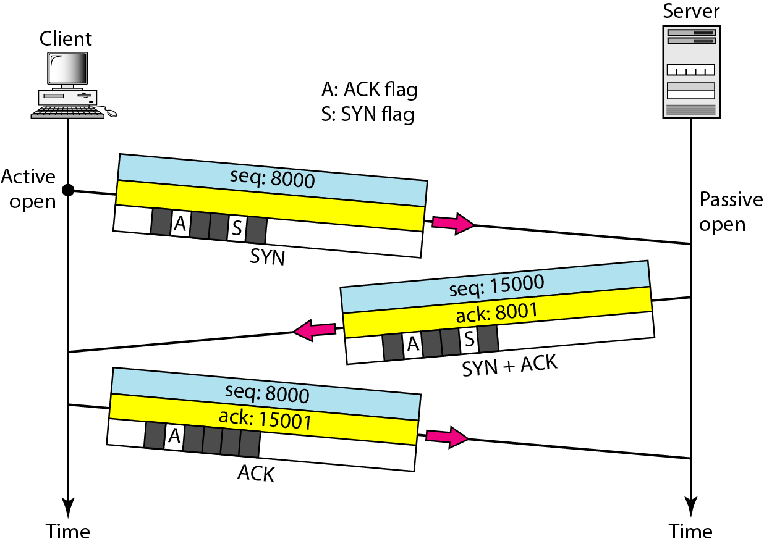
23CY101 – NETWORKING AND COMMUNICATION
Transport Layer – UDP - TCP
Connection establishment using three-way handshaking
MODULE: 3 38

Slide 40
23CY101 – NETWORKING AND COMMUNICATION
Transport Layer – UDP - TCP
A SYN segment cannot carry data, but it consumes one sequence number.
A SYN + ACK segment cannot carry data, but does consume one sequence number.
An ACK segment, if carrying no data, consumes no sequence number.
MODULE: 3 39

Slide 41
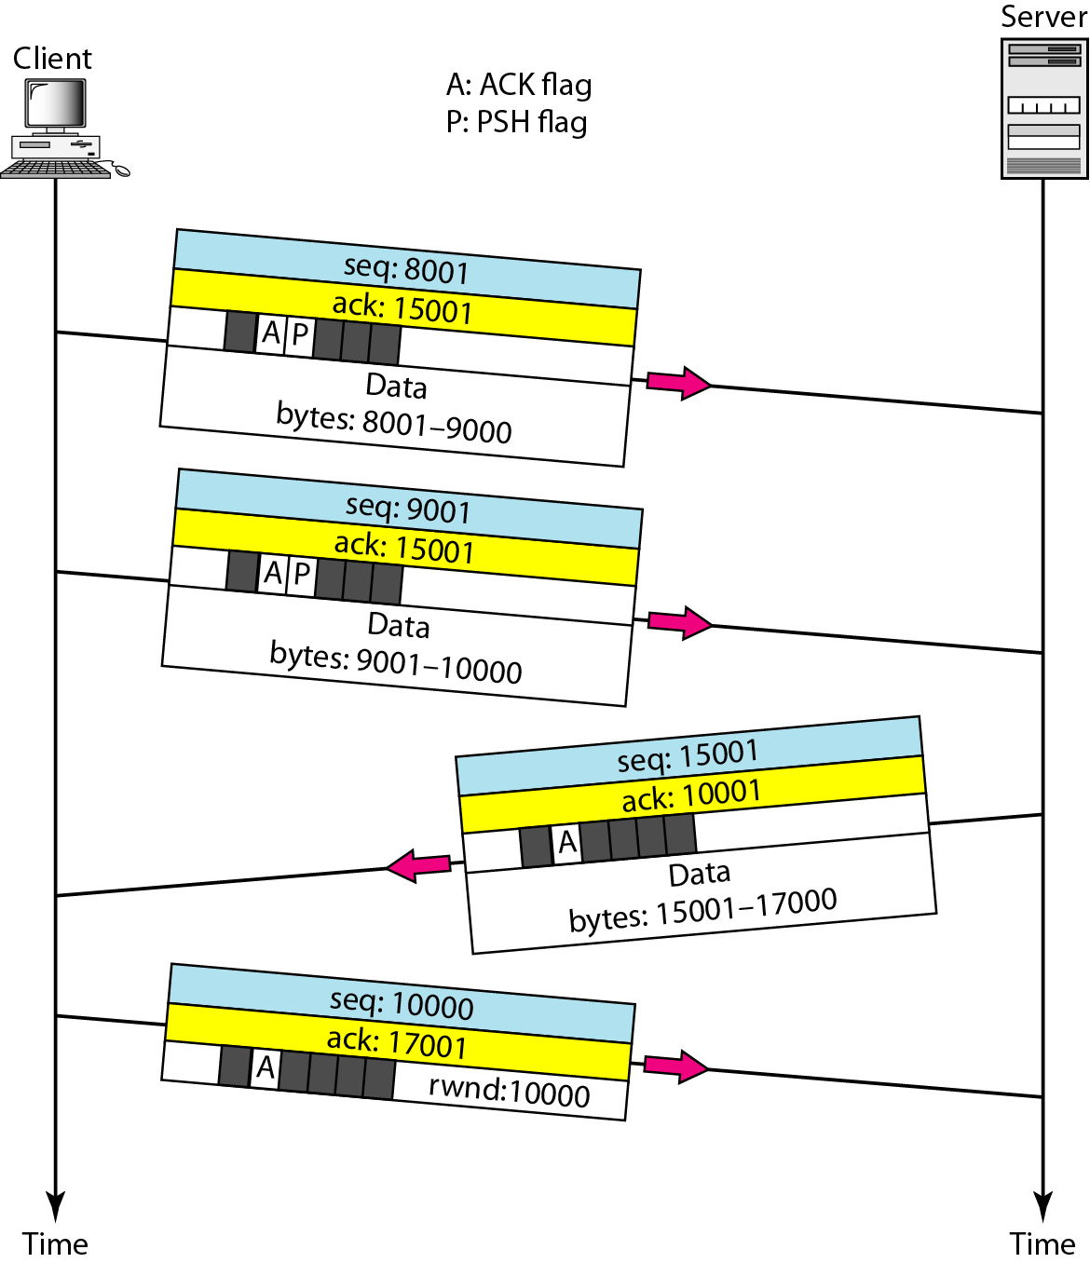
23CY101 – NETWORKING AND COMMUNICATION
Transport Layer – UDP - TCP
Data Transfer
MODULE: 3 40

Slide 42
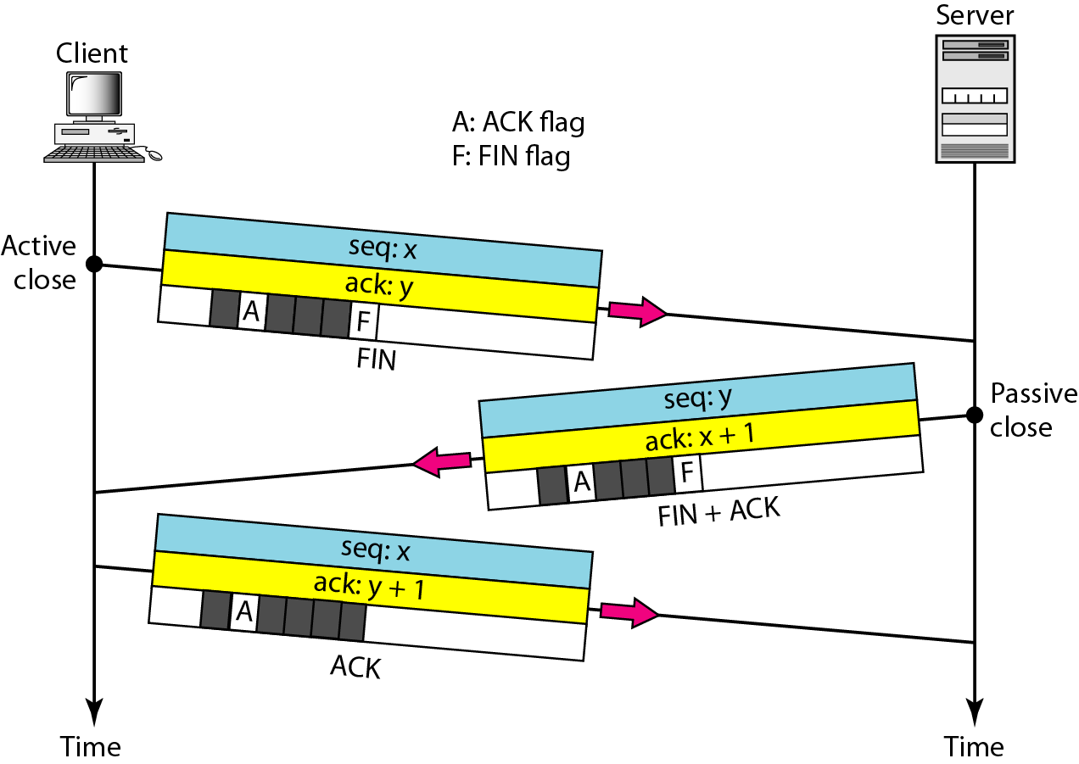
23CY101 – NETWORKING AND COMMUNICATION
Transport Layer – UDP - TCP
Connection termination using three-way handshaking
MODULE: 3 41

Slide 43
23CY101 – NETWORKING AND COMMUNICATION
Transport Layer – UDP - TCP
The FIN segment consumes one sequence number if it does not carry data.
The FIN + ACK segment consumes one sequence number if it does not carry data.
MODULE: 3 42

Slide 44
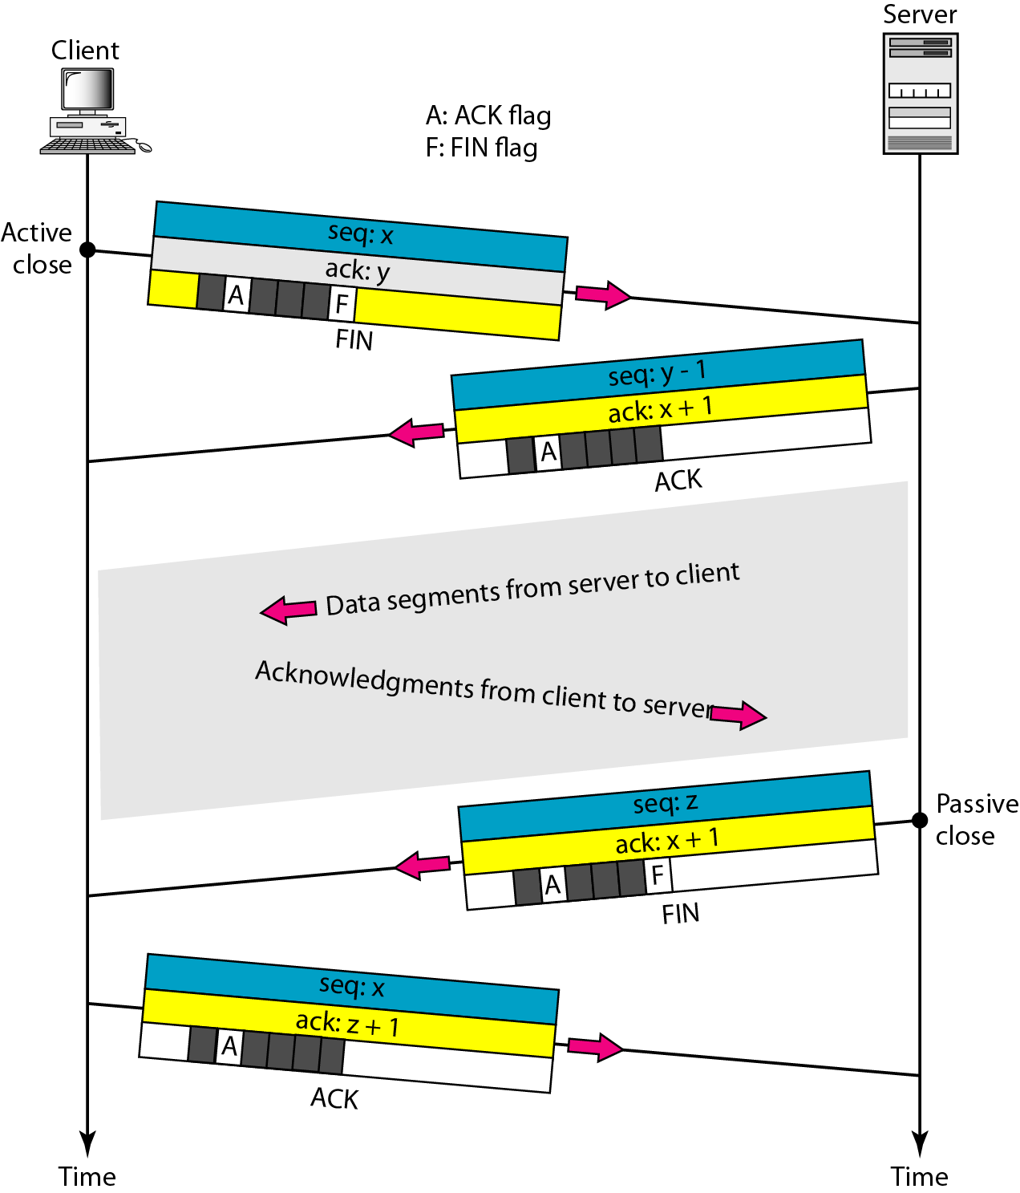
23CY101 – NETWORKING AND COMMUNICATION
Transport Layer – UDP - TCP
Half-close
MODULE: 3 43

